Slide 1
Unit 2: IP Technology
Unit goals:
understand principles behind network layer services:
IPv4/IPv6 technology
IPv6 addressing
IPv6 operation mode
IPv4/IPv6 co-exist technologies including translating and tunneling.

Slide 2
Unit 2: IP Technology
2. 1 Introduction
2.2 Virtual circuit and datagram networks
2.3 IPv4
Datagram format
IPv4 addressing
ICMP
2.4 IPv6:
Protocol Background
Technology Highlights
IPv4-IPv6 Coexistence/Transition
Next Steps

Slide 3

Network layer
transport segment from sending to receiving host
on sending side encapsulates segments into datagrams
on rcving side, delivers segments to transport layer
network layer protocols in every host, router
router examines header fields in all IP datagrams passing through it
application
transport
network
data link
physical
network
data link
physical
network
data link
physical
network
data link
physical
network
data link
physical
network
data link
physical
network
data link
physical
network
data link
physical
network
data link
physical
network
data link
physical
application
transport
network
data link
physical
network
data link
physical
network
data link
physical

Slide 4
Two Key Network-Layer Functions
analogy
forwarding: move packets from router’s input to appropriate router output
IP protocol
involves the transfer of a packet from an incoming link to an outgoing link within a single router
routing: determine route taken by packets from source to dest.
routing algorithms
involves all of a network's routers
forwarding: process of getting through single interchange
routing: process of planning trip from source to dest.

Slide 5
Unit 2: IP Technology
2. 1 Introduction
2.2 Virtual circuit and datagram networks
2.3 IPv4
Datagram format
IPv4 addressing
ICMP
2.4 IPv6:
Protocol Background
Technology Highlights
IPv4-IPv6 Coexistence/Transition
Next Steps

Slide 6
Network layer connection and connection-less service
Packet switched networks are categorized into datagram networks and virtual circuit networks
Datagram network provides network-layer connectionless service (analogous to UDP)
Virtual circuit (VC) network provides network-layer connection service (analogous to TCP)
analogous to the transport-layer services, but:
service: host-to-host (what about transport layer?)
no choice: network provides one or the other
implementation: in network core and end systems

Slide 7
Virtual circuits (VC)
“source-to-dest path behaves much like telephone (circuit-switched networks) circuit”
performance-wise
network actions along source-to-dest path
call setup for each call before data can flow and teardown afterwards
each packet carries VC identifier (not destination host address)
every router on source-dest path maintains “state” for each passing connection
link, router resources (bandwidth, buffers) may be allocated to VC (dedicated resources = predictable service)

Slide 8
VC implementation
a VC consists of:
path from source to destination
VC numbers, one number for each link along path
entries in forwarding tables in routers along path
packet belonging to VC carries VC number (rather than dest. address)
VC number can be changed on each link.
New VC number comes from forwarding table
Why doesn't a packet just keep the same VC number on each of the links along its route?

Slide 9
Forwarding table
VC number
Whenever a new VC is established across a router, an entry is added to the forwarding table.
Whenever a VC terminates, the appropriate entries are removed.
12
22
32
1
3
2
interface
number
Forwarding table in
northwest router:
Incoming interface Incoming VC # Outgoing interface Outgoing VC #
1 12 3 22
2 63 1 18
3 7 2 17
1 97 3 87
… … … …
Routers maintain connection state information!

Slide 10
Virtual circuits: signaling protocols
used to setup, maintain, teardown VC
used in ATM, frame-relay, X.25
not used in today’s Internet
application
transport
network
data link
physical
5. Data flow begins
6. Receive data
application
transport
network
data link
physical
4. Call connected
3. Accept call
1. Initiate call
2. incoming call

Slide 11
Datagram networks
no call setup at network layer
routers: no state about end-to-end connections
no network-level concept of “connection”
packets forwarded using destination host address
packets between same source-dest pair may take different paths
application
transport
network
data link
physical
application
transport
network
data link
physical
1. Send data
2. Receive data

Slide 12
Datagram or VC network: why?
Internet (datagram)
data exchange among computers
“elastic” service, no strict timing req.
“smart” end systems (computers)
can adapt, perform control, error recovery
simple inside network, complexity at “edge”
many link types
different characteristics
uniform service difficult
ATM (VC)
evolved from telephony
human conversation:
strict timing, reliability requirements
need for guaranteed service
“dumb” end systems
telephones
complexity inside network
Notes:
Asynchronous Transfer Mode (ATM) is, according to the ATM Forum, "a telecommunications concept defined by ANSI and ITU (formerly CCITT) standards for carriage of a complete range of user traffic, including voice, data, and video signals".^{[1]} ATM was developed to meet the needs of the Broadband Integrated Services Digital Network, as defined in the late 1980s,^{[2]} and designed to unify telecommunication and computer networks. It was designed for a network that must handle both traditional high-throughput data traffic (e.g., file transfers), and real-time,low-latency content such as voice and video. The reference model for ATM approximately maps to the three lowest layers of the ISO-OSI reference model: network layer, data link layer, and physical layer.^{[3]} ATM is a core protocol used over the SONET/SDH backbone of the public switched telephone network (PSTN) and Integrated Services Digital Network (ISDN), but its use is declining in favour of all IP.
ATM uses a connection-oriented model in which a virtual circuit must be established between two endpoints before the actual data exchange begins.^{[5]} These virtual circuits may be “permanent”, i.e. dedicated connections that are usually preconfigured by the service provider, or “switched”, i.e. set up on a per-call basis using signalling and disconnected when the call is terminated.
ATM became popular with telephone companies and many computer makers in the 1990s. However, even by the end of the decade, the better price/performance of Internet Protocol-based products was competing with ATM technology for integrating real-time and bursty network traffic.^{[13]} Companies such as FORE Systems focused on ATM products, while other large vendors such as Cisco Systems provided ATM as an option.^{[14]} After the burst of the dot-com bubble, some still predicted that "ATM is going to dominate".^{[15]} However, in 2005 the ATM Forum, which had been the trade organization promoting the technology, merged with groups promoting other technologies, and eventually became theBroadband Forum.^{[16]}

Slide 13
Unit 2: IP Technology
2. 1 Introduction
2.2 Virtual circuit and datagram networks
2.3 IPv4
Datagram format
IPv4 addressing
ICMP
2.4 IPv6:
Protocol Background
Technology Highlights
IPv4-IPv6 Coexistence/Transition
Next Steps

Slide 14
Internet Protocol (IP)
Application layer
HTTP, FTP, SMTP
Application services
Transport layer
TCP, UDP
Reliable Transport service
ICMP
IGMP
Connectionless Packet Delivery Service
IP
Internet layer
RARP
ARP
Host to network layer
Different network interfaces
Physical hardware
ARP (Address Resolution Protocol)
RARP (Reverse Address Resolution Protocol)
ICMP (Internet Control Message Protocol)
IGMP (Internet Group Management Protocol)
IP
Address
ARP
Physical
Address
Physical
Address
RARP
IP
Address

Slide 15
IP Address and Physical Address
H
Application layer message
IP Address
TCP segment
Internet layer and above
using IP address
H
Physical
Address
IP datagram
H
T
Link layer and below
using physical address
MAC frame
Two machines on a given physical network can communicate only if they know each other’s physical network address.
Our goal, however, is to devise software that hides physical addresses and allows higher-level programs to work only with Internet addresses.

Slide 16
MAC Addresses
32-bit IP address:
network-layer address
used to get datagram to destination IP subnet
MAC (Media Access Control) address, or LAN or physical or Ethernet address:
function: get frame from one interface to another physically-connected interface (same network)
48 bit MAC address (for most LANs)
Each adapter on LAN has unique LAN address
Burned in Network Interface Card (NIC) ROM, also sometimes software settable

Slide 17

LAN Address (more)
MAC address allocation administered by IEEE
manufacturer buys portion of MAC address space (to assure uniqueness)
analogy:
(a) MAC address:
like Social Security Number
(b) IP address:
like postal address
MAC flat address ➜ portability
can move LAN card from one LAN to another
IP hierarchical address NOT portable
address depends on IP subnet to which node is attached

Slide 18
ARP: Address Resolution Protocol (1)
ARP permits machines to resolve addresses without keeping a permanent record of bindings.
To avoid maintaining a centralized database, the designers chose to use a low-level protocol (ARP) to bind addresses dynamically.

Slide 19
ARP: Address Resolution Protocol (2)
Q: how to determine
MAC address of B
knowing B’s IP address?
Each IP node (host, router) on LAN has ARP table
ARP table: IP/MAC address mappings for some LAN nodes
< IP address; MAC address; TTL>
A cache of recently required address bindings
TTL (Time To Live): time after which address mapping will be forgotten (typically 20 min)
137.196.7.78
1A-2F-BB-76-09-AD
137.196.7.23
137.196.7.14
LAN
71-65-F7-2B-08-53
58-23-D7-FA-20-B0
0C-C4-11-6F-E3-98
137.196.7.88

Slide 20
ARP protocol: Same LAN (network)
A wants to send datagram to B, and B’s MAC address not in A’s ARP table.
A broadcasts ARP query packet, containing B's IP address
dest MAC address = FF-FF-FF-FF-FF-FF
all machines on LAN receive ARP query
B receives ARP packet, replies to A with its (B's) MAC address
frame sent to A’s MAC address (unicast)
A caches (saves) IP-to-MAC address pair in its ARP table until information becomes old (times out)
soft state: information that times out (goes away) unless refreshed
ARP is “plug-and-play”:
nodes create their ARP tables without intervention from net administrator
A
x
B
y
A
x
B
y

Slide 21
host H₁
host H₂
Hardware
address
IP₁
R₁
IP₂
R₂
HA₁
LAN
HA₃
HA₄
LAN
HA₅
HA₆
LAN
HA₂
host H₁
Host H₂
IP datagram
R₁
R₂
IP₁ IP₂
IP₁ IP₂
IP₁ IP₂
IP₁
IP₂
IP₃
IP₄
IP₅
IP₆
IP layer Internet
HA₁
HA₃
HA₄
HA₅
HA₆
HA₂
HA₁ HA₃
HA₄HA₅
HA₆HA₂
MAC frame
MAC frame
MAC frame

Slide 22
Unit 2: IP Technology
2. 1 Introduction
2.2 Virtual circuit and datagram networks
2.3 IPv4
Datagram format
IPv4 addressing
ICMP
2.4 IPv6:
Protocol Background
Technology Highlights
IPv4-IPv6 Coexistence/Transition
Next Steps

Slide 23
IP datagram format
IP protocol version
number
32 bits
total datagram
length (bytes)
0
4
8
16
19
24
31
header length
(bytes)
head.
len
type of
service
ver
total length
for
fragmentation/
reassembly
fragment
offset
“type” of data
16-bit identifier
flgs
time to
Live (TTL)
upper
layer
header
checksum
Fixed length: 20 Byte
max number
remaining hops
(decremented at
each router)
32 bit source IP address
32 bit destination IP address
Theoretically max. 64 KByte
576 B <normal len. <=1500B
due to MTU
options (if any)
padding
upper layer protocol
to deliver payload to
E.g. timestamp,
record route
taken, specify
list of routers
to visit
(max. 40 Byte).
data
(variable length,
typically a TCP
or UDP segment)

Slide 24
IP Fragmentation & Reassembly
network links have MTU (maximum transmission unit) - largest possible link-level frame.
different link types, different MTUs
large IP datagram divided (“fragmented”) within net
one datagram becomes several datagrams
“reassembled” only at final destination
IP header bits used to identify, order related fragments
fragmentation:
in: one large datagram
out: 3 smaller datagrams
reassembly

Slide 25
IP Fragmentation and Reassembly
length
=4000
ID
=x
fragflag
=0
offset
=0
Example
4000 byte datagram
MTU = 1500 bytes
One large datagram becomes
several smaller datagrams
length
=1500
ID
=x
fragflag
=1
offset
=0
1480 bytes in data field
length
=1500
ID
=x
fragflag
=1
offset
=185
offset =
1480/8
length
=1040
ID
=x
fragflag
=0
offset
=370

Slide 26
Unit 2: IP Technology
2. 1 Introduction
2.2 Virtual circuit and datagram networks
2.3 IPv4
Datagram format
IPv4 addressing
ICMP
2.4 IPv6:
Protocol Background
Technology Highlights
IPv4-IPv6 Coexistence/Transition
Next Steps

Slide 27
IP Addressing: introduction
IP address: 32-bit binary identifier for host, router interface
interface: connection between host/router and physical link
router’s typically have multiple interfaces
host typically has one interface
IP addresses associated with each interface
223.1.1.1
223.1.2.1
223.1.1.2
223.1.1.4
223.1.2.9
223.1.2.2
223.1.1.3
223.1.3.27
223.1.3.1
223.1.3.2
223.1.1.1 = 11011111 00000001 00000001 00000001
223
1
1
1

Slide 28
Calculation
IP addresses are written as four decimal integers separated by decimal points, where each integer gives the value of one octet of the IP address. Thus the 32-bit IP address
10000000 00001010 00000010 00011110
2⁷
(2³+2¹)
2¹
(2⁴+2³+2²+2¹)
128.10.2.30
1 1 1 1 1 1 1 1
2⁷ 2⁶ 2⁵ 2⁴ 2³ 2² 2¹ 2⁰
128 64 32 16 8 4 2 1

Slide 29
Addresses Specify Network Connections
A conventional computer that has two or more physical network connections is called multi-homed hosts.
Each of the machine’s network connections must be assigned an address.
An address does not specify an individual computer, but a connection to a network.
The most obvious disadvantage in an internet address is that addresses refer to network connections, not to the host computer (e.g., if a host computer moves from one network to another, its IP address must change).

Slide 30
Classful IP Addresses
Dotted Decimal Notation
class
32 bits
8
16
24
31
A
0
net id
host id
1.0.0.0. to
127.0.0.0
B
10
14-bit net id
host id
128.0.0.0 to
191.255.0.0
C
110
21-bit net id
host id
192.0.0.0 to
223.255.255.0
D
1110
multicast address
224.0.0.0 to
239.255.255.255
E
1111
reserved for future use
240.0.0.0 to
255.255.255.254
The range of dotted decimal values that correspond to each IP address class.
Some values are reserved for special purposes.

Slide 31
Special forms of IP address
net id | host id | valid source | valid destination | representation/comments
0 | 0 | yes | no | Startup source address
0 | host-id | yes | no | An host in this network
all 1s | all 1s | no | yes | Limited/ local network broadcast
net-id | all 1s | no | yes | Directed broadcast for the network net-id
net-id | all 0s | no | yes | The network itself/directed broadcast
127 | Not all 0s or all 1s | yes | yes | Loopback test for the host (127 is not a network address)
Note: Routers along the path use only the net-id portion of the address when deciding how to forward the datagram.

Slide 32
Direct and Indirect Delivery
10.0.0.4
20.0.0.7
20.0.0.9
30.0.0.2
30.0.0.1
40.0.0.4
R₁
R₂
R₃
N₁
10.0.0.0
N₂
20.0.0.0
N₃
30.0.0.0
N₄
40.0.0.0
0
1
Routing table in R₂
The final router deliver datagram directly
To reach hosts on network
Next hop
20.0.0.0
Direct delivery，interface 0
30.0.0.0
Direct delivery，interface 1
10.0.0.0
20.0.0.7
Q: Can this IP address be written into the datagram?
40.0.0.0
30.0.0.1
10.0.0.4
20.0.0.7
20.0.0.9
30.0.0.2
30.0.0.1
40.0.0.4
R₁
R₂
R₃
Link 1
Link 2
Link 3
Link 4

Slide 33
Default Routes
Another technique, used to hide information and keep routing table sizes small, consolidates multiple entries into a default case.
Default forwarding is especially useful when a site has a small set of local addresses and only one connection to the rest of the internet.
Routing table in any host of network N₁
N₂
R₂
Dest. Network Next hop
N₁ Direct
N₂ R₂
Default R₁
R₁
N₁
Internet

Slide 34
Advantages and Disadvantages of the Original Classful IP Addressing scheme
The chief advantage: A router can keep one routing entry per network instead of per destination host.
Use classful addressing to determine the boundary between prefix and suffix, e.g., Class A partitioned an address into 8-bit network portion and a 24-bit host portion.
Weakness: Requiring a unique prefix for each physical network would exhaust the address space quickly as the Internet proliferates.
Q: How can technology accommodate growth without abandoning the original classful addressing scheme?
A: In order to reduce the number of network prefixes used, three survival solutions are: ❶unnumbered point-to-point links, ❷proxy ARP, and ❸subnet addressing.

Slide 35
Subnet Addressing / Subnetting
Conceptually, adding subnets only changes the interpretation of IP addresses slightly.
Routers only examine the network prefix. The interpretation of the local portion of an address is left up to the site.
Internet
part
local
part
Internet
part
physical
network
host
Subnet mask (“AND” operation):
Network Identifier
Host Identifier
11111111 11111111 11111111 00000000
255.255.255.0

Slide 36
Subnets
IP address:
subnet part (high order bits)
host part (low order bits)
What’s a subnet ?
device interfaces with same subnet part of IP address
can physically reach each other without intervening router
223.1.1.1
223.1.2.1
223.1.1.2
223.1.1.4
223.1.2.9
223.1.1.3
223.1.2.2
223.1.3.27
subnet
223.1.3.1
223.1.3.2
network consisting of 3 subnets

Slide 37
Subnets
N1
223.1.1.2
How many?
223.1.1.1
223.1.1.4
In particular, because IP views a point-to-point connection between a pair of machines as a “network”, the connection was assigned a network prefix and each computer was assigned a host suffix.
When addresses became scarce, no IP addresses will be assigned to this kind of special networks which consist of only one line
223.1.1.3
223.1.9.2
223.1.7.0
N4
N5
223.1.9.1
223.1.7.1
223.1.8.1
223.1.8.0
223.1.2.6
N6
223.1.3.27
223.1.2.1
223.1.2.2
223.1.3.1
223.1.3.2
N2
N3

Slide 38
Example 1: Given IP: 141.14.72.24, subnet mask: 255.255.192.0, What is the network address?
(a) Dotted decimal IP address
141 . 14 .
72 . 24
(b) 3rd octet of IP address is
written as binary
141 . 14 .
0 1 0 0 1 0 0 0
. 24
(c) Subnet mask 255.255.192.0
1 1 1 1 1 1 1 1 1 1 1 1 1 1 1 1 1 1 0 0 0 0 0 0
0 0 0 0 0 0 0 0
(d) “AND” operation on each bit
between IP address and subnet mask
141 . 14 . 0 1 0 0 0 0 0 0
. 0
(e) Network address
141 . 14 .
64 . 0

Slide 39
Example 2: The same IP address, but subnet mask is changed to 255.255.240.0. What is the network address now?
(a) Dotted decimal IP address
141 . 14 .
72 . 24
(b) 3rd octet of IP address is
written as binary
141 . 14 .
0 1 0 0 1 0 0 0
. 24
(c) Subnet mask 255.255.240.0
1 1 1 1 1 1 1 1 1 1 1 1 1 1 1 1 1 1 1 0 0 0 0 0
0 0 0 0 0 0 0 0
(d) “AND” operation on each bit
between IP address and subnet mask
141 . 14 . 0 1 0 0 0 0 0 0
. 0
(e) Network address
141 . 14 .
64 . 0
Q: We got the same network address,
what is the difference?

Slide 40
Example 3: The routing table in R₁ is given. Host H₁ sends packets to host H₂. Discuss the process of H₁ consulting the routing table of R₁.
Routing table in R₁
128.30.33.13
Dest. Network | Subnet mask | Next hop
128.30.33.0 128.30.33.128 128.30.36.0 | 255.255.255.128 255.255.255.128 255.255.255.0 | Interface 0 Interface 1 R₂
H₁
Subnet 1：
network address 128.30.33.0
subnet mask 255.255.255.128
128.30.33.1
0
255.255.255.128 AND 128.30.33.138 = 128.30.33.128
R₁
Subnet 2: network address 128.30.33.128
subnet mask 255.255.255.128
128.30.33.130
1
0
128.30.33.129
R₂
H₂
128.30.33.138
1
128.30.36.2
Subnet 3：network address 128.30.36.0
subnet address 255.255.255.0
H₃
128.30.36.12

Slide 41
Anonymous Point-to-Point Networks
Goal: to avoid assigning a prefix to each point-to-point connection
Unnumbered/anonymous network: anonymous networking technique is applied to a point-to-point connection
128.10.0.0
128.211.0.0
R₁
R₂
Leased serial line
1
2
128.10.2.250
128.211.0.100
Routing table in R₁
To reach hosts on network | Route to this address | Using this interface
128.10.0.0 | Direct Delivery | 1
default | 128.211.0.100 | 2

Slide 42
Classless Addressing and Supernetting
Classless Inter-Domain Routing (CIDR) was invented to use address space more efficiently.
32-bit address mask to specify the boundary between prefix and suffix (two-level hierarchy)
variable-length subnet
CIDR notation or Slash notation: a.b.c.d/x, where x is # bits in subnet portion of address
The supernetting scheme allows an ISP to assign the organization a block of class C addresses instead of a single class B number.
 | Dotted decimal | 32-bit binary Equivalent
Lowest address | 128.211.168.0/21 | 10000000 11010011 10101000 00000000
Highest address | 128.211.175.255/21 | 10000000 11010011 10101111 11111111
Address mask | 255.255.248.0 | 11111111 11111111 11111000 00000000
A block of 2¹¹ contiguous addresses
Notes:
prefix 搜索网络
英 [ˈpri:fɪks] 美 [ˈpriˌfɪks]
IELTS
n. <语>前缀; 人名前的称谓; 前置代号（置于前面的单词或字母、数字）;
变形 复数: prefixes
suffix 搜索网络
英 [ˈsʌfɪks] 美 [ˈsʌfɪks]
IELTS
n. 后缀，词尾;
vt. 加后缀，加词尾;
变形 复数: suffixes

Slide 43
Often used CIDR Address blocks
Prefix length | Dotted decimal | # addresses | Eqv. # network
/13 | 255.248.0.0 | 2¹⁹=512K | 2¹¹ class C
/14 | 255.252.0.0 | 2¹⁸=256K | 2¹⁰ class C
/15 | 255.254.0.0 | 2¹⁷=128K | 2⁹ class C
/16 | 255.255.0.0 | 2¹⁶=64K | 2⁸ class C
/17 | 255.255.128.0 | 2¹⁵=32K | 2⁷ class C
/18 | 255.255.192.0 | 2¹⁴=16K | 2⁶ class C
/19 | 255.255.224.0 | 2¹³=8K | 2⁵ class C
/20 | 255.255.240.0 | 2¹²=4K | 2⁴ class C
/21 | 255.255.248.0 | 2¹¹=2K | 2³ class C
/22 | 255.255.252.0 | 2¹⁰=1K | 2² class C
/23 | 255.255.254.0 | 2⁹=512 | 2¹ class C
/24 | 255.255.255.0 | 2⁸=256 | 2⁰ class C
/25 | 255.255.255.128 | 2⁷=128 | 1/2class C
/26 | 255.255.255.192 | 2⁶=64 | 1/4class C
/27 | 255.255.255.224 | 2⁵=32 | 1/8 class C

Slide 44
Hierarchical addressing: route aggregation
Hierarchical addressing allows efficient advertisement of routing information:
Organization 0
200.23.16.0/23
Organization 1
200.23.18.0/23
“Send me anything
with addresses
beginning
200.23.16.0/20”
Organization 2
200.23.20.0/23
.
Fly-By-Night-ISP
.
.
.
.
Internet
Organization 7
.
200.23.30.0/23
ISPs-R-Us
“Send me anything
with addresses
beginning
199.31.0.0/16”

Slide 45
Hierarchical addressing: more specific routes
ISPs-R-Us has a more specific route to Organization 1
Organization 0
200.23.16.0/23
“Send me anything
with addresses
beginning
200.23.16.0/20”
Organization 2
200.23.20.0/23
.
Fly-By-Night-ISP
.
.
.
.
Internet
Organization 7
.
200.23.30.0/23
ISPs-R-Us
“Send me anything
with addresses
beginning 199.31.0.0/16
or 200.23.18.0/23”
Organization 1
200.23.18.0/23

Slide 46
One Example
What is the network address aggregating 16 successive network addresses from 194.24.16.0/24 to 194.24.31.0/24?
sol) If we compute the common prefix belonging to all the 16 network addresses, the aggregate address is 194.24.16.0/20
11000010 00011000 00010000 00000000 194.24.16.0/24
11000010 00011000 00011111 00000000 194.24.31.0/24
11000010 00011000 00010000 00000000 194.24.16.0/20
4 bits, 2⁴=16 successive network addresses

Slide 47
A CIDR example
ISP
University X
206.0.64.0/18
Internet
206.0.68.0/22
206.0.68.0/23
206.0.70.0/24
206.0.71.0/25
206.0.71.128/25
206.0.68.0/25
206.0.68.128/25
206.0.69.0/25
206.0.69.128/25
206.0.70.0/26
206.0.70.64/26
206.0.70.128/26
206.0.70.192/26
206.0.71.0/26
206.0.71.64/26
206.0.71.128/26
206.0.71.192/26
Dept. 3
Dept. 4
Dept. 1
Dept. 2
Unit Address block Binary representation Total Addresses
ISP 206.0.64.0/18 11001110.00000000.01* 16384
Univ. 206.0.68.0/22 11001110.00000000.010001* 1024
Dept.1 206.0.68.0/23 11001110.00000000.0100010* 512
Dept.2 206.0.70.0/24 11001110.00000000.01000110.* 256
Dept.3 206.0.71.0/25 11001110.00000000.01000111.0* 128
Dept.4 206.0.71.128/25 11001110.00000000.01000111.1* 128

Slide 48
Longest Match and Mixture of Route Types
Dest. Address of a datagram D = 206.0.71.128
Items in routing table: 206.0.68.0/22 (ISP)
206.0.71.128/25 (Dept. 4)
M₁ = 11111111 11111111 11111100 00000000 /22
AND D = 206. 0. 01000111.10000000
206. 0. 01000100. 0
M₂ = 11111111 11111111 11111111 10000000 /25
AND D = 206. 0. 71. 10000000
206. 0. 71. 10000000
Match 206.0.68.0/22
Match 206.0.71.128/25

Slide 49
IP addresses: how to get one?
Q: How does a host get IP address?
Static configuration: hard-coded by system admin in a file
Windows: control-panel->network->configuration->tcp/ip->properties
UNIX: /etc/rc.config
Dynamic configuration:
DHCP: Dynamic Host Configuration Protocol: dynamically get address from as server
“plug-and-play”

Slide 50
IP addressing: the last word...
Q: How does an ISP get a block of addresses used on the global Internet?
A: ICANN: Internet Corporation for Assigned
Names and Numbers http://www.icann.org/
allocates addresses
manages DNS
assigns domain names, resolves disputes
NOTE:
1. Only largest ISPs need to contact one of the address registries (ARIN, RIPE, APNIC, LATNIC, or AFRINIC).
2. Local ISP obtains prefixes from larger ISPs and assign a unique suffix to each host without contacting the central authority.

Slide 51
NAT: Network Address Translation
rest of
Internet
local network
(e.g., home network)
10.0.0.0/24
10.0.0.1
NAT Router
10.0.0.4
10.0.0.2
138.76.29.7
10.0.0.3
All datagrams leaving local
network have same single source NAT IP address: 138.76.29.7,
different source port numbers
Datagrams with source or
destination in this network
have 10.0.0.0/24 address for
source, destination (as usual)

Slide 52
Private Addresses /Non-routable Addresses
CIDR blocks reserved for use within a site (private network)
Must never appear on the Internet
ISPs do not maintain routes
Prefix | Lowest Address | Highest Address
10.0.0.0/8 | 10.0.0.0 | 10.255.255.255
172.16.0.0/12 | 172.16.0.0 | 172.31.255.255
192.168.0.0/16 | 192.168.0.0 | 192.168.255.255
169.254.0.0/16 | 169.254.0.0 | 169.254.255.255

Slide 53
NAT: Network Address Translation
Motivation: local network uses just one IP address as far as outside world is concerned:
range of addresses not needed from ISP: just one IP address for all devices
can change addresses of devices in local network without notifying outside world
can change ISP without changing addresses of devices in local network
devices inside local net not explicitly addressable, visible by outside world (a security plus).

Slide 54
NAT: Network Address Translation
Implementation: NAT router must:
outgoing datagrams: replace (source IP address, port #) of every outgoing datagram to (NAT IP address, new port #)
. . . remote clients/servers will respond using
(NAT IP address, new port #) as destination addr.
remember (in NAT translation table) every
(source IP address, port #) to (NAT IP address, new port #) translation pair
incoming datagrams: replace (NAT IP address, new port #) in dest. fields of every incoming datagram with corresponding (source IP address, port #) stored in NAT table

Slide 55
NAT: Network Address Translation
NAT translation table
WAN side addr LAN side addr
1: host 10.0.0.1
sends datagram to
128.119.40.186, 80
2: NAT router
changes datagram
source addr from
10.0.0.1, 3345 to
138.76.29.7, 5001,
updates table
138.76.29.7, 5001 10.0.0.1, 3345
…… ……
S: 10.0.0.1, 3345
D: 128.119.40.186, 80
10.0.0.1
1
2
S: 138.76.29.7, 5001
D: 128.119.40.186, 80
10.0.0.4
10.0.0.2
138.76.29.7
S: 128.119.40.186, 80
D: 10.0.0.1, 3345
4
S: 128.119.40.186, 80
D: 138.76.29.7, 5001
3
10.0.0.3
4: NAT router
changes datagram
dest addr from
138.76.29.7, 5001 to 10.0.0.1, 3345
3: Reply arrives
dest. address:
138.76.29.7, 5001

Slide 56
Features of NAT
Benefits:
Simple Gateway between Internet and Private Network
Simple Security Due to Stateful Filter Implementation
Privacy and Topology Hiding
16-bit port-number field
Some prefixes reserved for use with private internets not connected to the global Internet.
NAT is controversial:
routers should only process up to layer 3 (but NAT provide services of transport layer), violates end-to-end argument
address shortage should instead be solved by IPv6
Notes:
controversial 搜索网络
英 [ˌkɒntrəˈvɜ:ʃl] 美 [ˌkɑntrəˈvɜrʃl]
考研 | IELTS | TOEFL | GRE
adj. 有争议的，引起争议的，被争论的; 好争论的;

Slide 57
NAT traversal problem
client wants to connect to server with address 10.0.0.1
server address 10.0.0.1 local to LAN (client can’t use it as destination addr)
only one externally visible NATted address: 138.76.29.7
solution 1: statically configure NAT to forward incoming connection requests at given port to server
e.g., (138.76.29.7, port 2500) always forwarded to 10.0.0.1 port 25000
10.0.0.1
Client
?
10.0.0.4
138.76.29.7
NAT
router

Slide 58
NAT traversal problem
solution 2: Universal Plug and Play (UPnP) Internet Gateway Device (IGD) Protocol. Allows NATted host to:
learn public IP address (138.76.29.7)
add/remove port mappings (with lease times)
i.e., automate static NAT port map configuration
10.0.0.1
IGD
10.0.0.4
138.76.29.7
NAT
router
Notes:
traversal 搜索网络
英 [træ'vɜ:sl] 美 ['trævɜsəl]
n. 横越，横断物，（横向）往返移动;

Slide 59


NAT traversal problem
solution 3: relaying (used in Skype)
NATed client establishes connection to relay
External client connects to relay
relay bridges packets between to connections
2. connection to
relay initiated
by client
1. connection to
relay initiated
by NATted host
10.0.0.1
3. relaying
established
Client
138.76.29.7
NAT
router

Slide 60
Unit 2: IP Technology
2. 1 Introduction
2.2 Virtual circuit and datagram networks
2.3 IPv4
Datagram format
IPv4 addressing
ICMP
2.4 IPv6:
Protocol Background
Technology Highlights
IPv4-IPv6 Coexistence/Transition
Next Steps

Slide 61
ICMP: Internet Control Message Protocol
used by hosts & routers to communicate network-level information
error reporting: unreachable host, network, port, protocol
echo request/reply (used by ping)
network-layer “above” IP:
ICMP msgs carried in the data portion of IP datagrams
ICMP message: three fixed-length fields: 8-bit “type” field, 8-bit “code” field, 16-bit “checksum” field.
Type Code description
0 0 echo reply (ping)
3 0 dest. network unreachable
3 1 dest. host unreachable
3 2 dest. protocol unreachable
3 3 dest. port unreachable
3 6 dest. network unknown
3 7 dest. host unknown
4 0 source quench (congestion
control - not used)
8 0 echo request (ping)
9 0 route advertisement
10 0 router discovery
11 0 TTL expired
12 0 bad IP header

Slide 62
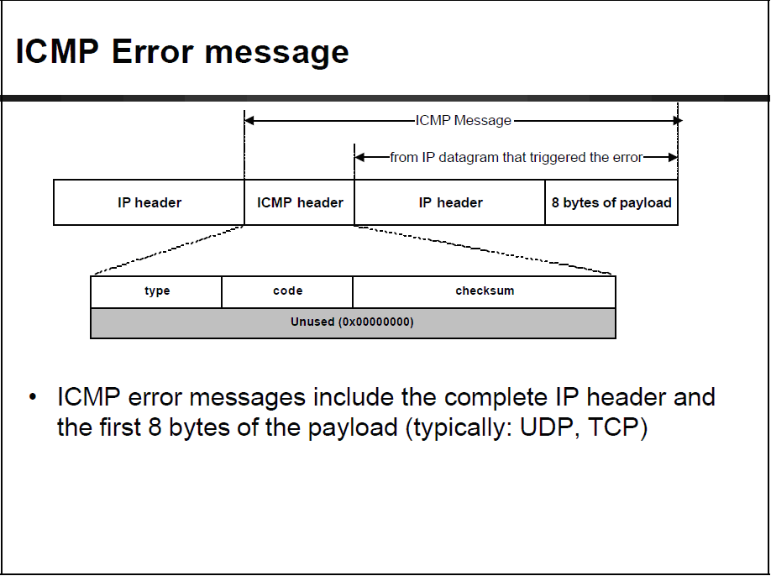

Slide 63
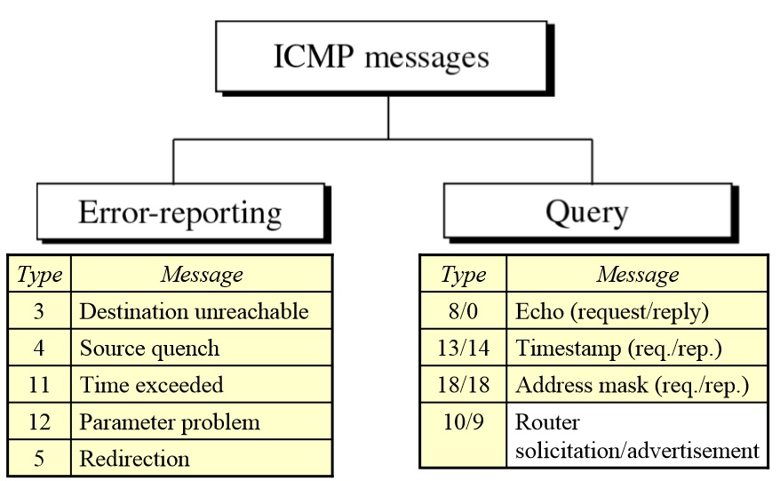

Slide 64
Unit 2: IP Technology
2. 1 Introduction
2.2 Virtual circuit and datagram networks
2.3 IPv4
Datagram format
IPv4 addressing
ICMP
2.4 IPv6:
Protocol Background
Technology Highlights
IPv4-IPv6 Coexistence/Transition
Next Steps

Slide 65
IPv6
Initial motivation: 32-bit address space soon to be completely allocated.
Additional motivation:
header format helps speed processing/forwarding
header changes to facilitate QoS
IPv6 datagram format:
fixed-length 40 byte header
no fragmentation allowed

Slide 66
What Ever Happened to IPv5?
0 IP March 1977 version (deprecated)
1 IP January 1978 version (deprecated)
2 IP February 1978 version A (deprecated)
3 IP February 1978 version B (deprecated)
4 IPv4 September 1981 version (current widespread)
5 ST Stream Transport (not a new IP, little use)
6 IPv6 December 1998 version (formerly SIP, SIPP)
7 CATNIP IPng evaluation (formerly TP/IX; deprecated)
8 Pip IPng evaluation (deprecated)
TUBA IPng evaluation (deprecated)
IPv6, originally know as “IP next generation (IPng)”
The first working version

Slide 67

… a longer term solution IP next generation (IPng)
1991: Work starts on next generation Internet protocols
More than 6 different proposals were developed
1993: IETF forms IPng Directorate
To select the new protocol by consensus
1995: IPv6 selected
Evolutionary (not revolutionary) step from IPv4
1996: 6Bone started
1998: IPv6 standardized
Today: Initial products and deployments

Slide 68
Design Philosophy
Recognizable yet simplified header format
Reduce common-case processing cost of packet handling
Keep bandwidth overhead low in spite of increased size of the address
Flexible and extensible support for option headers
Design optimised for 64-bit architecture
Headers are 64-bit aligned

Slide 69
Technologies & efforts to slow the consumption rate
Dial-access / PPP / DHCP
Provides temporary allocation aligned with actual endpoint use
Strict allocation policies
Reduced allocation rates by policy of “current-need” vs. previous policy based on “projected-maximum-size”
CIDR
Aligns routing table size with needs-based address allocation policy. Additional enforced aggregation actually lowered routing table growth rate to linear for a few years
NAT
Hides many nodes behind limited set of public addresses

Slide 70
Would increased use of NATs be adequate?
NO!
Public address consumption is still rising even with current NAT deployments
NAT enforces a “client-server” application model where the server has topological constraints
They won’t work for peer-to-peer or devices that are “called” by others (e.g., IP phones)
They inhibit deployment of new applications and services, because all NATs in the path have to be upgraded BEFORE the application can be deployed

Slide 71
Return to an End-to-End Architecture
New Technologies/Applications for Home Users “Always-on” – Cable, DSL, Ethernet@home, Wireless,…
Always-on Devices Need an Address When You Call Them
Global
Addressing
Realm

Slide 72
Why is a larger address space needed?
Overall Internet is still growing its user base
~320 million users in 2000
~550 million users by 2006
~1055 million users in 2010
~3460 million users up to now in 2016
Users expanding their connected device count
405 million mobile phones in 2000, over 3.3 billion by 2007, 4.77 billion by 2017.
~1 billion cars in 2010
15% likely to use GPS and locality based Yellow Page services
Billions of new Internet appliances for Home users

Slide 73
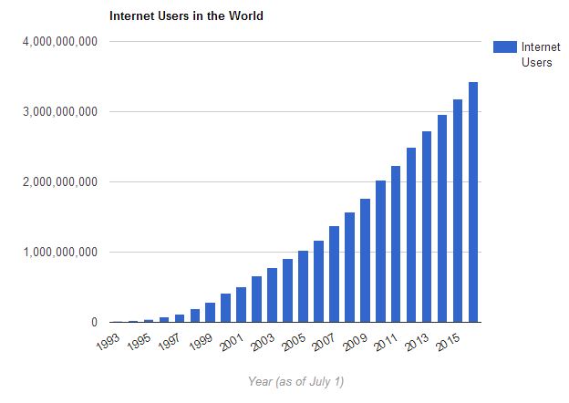
Internet users in the world
Internet User = individual who can access the Internet at home, via any device type and connection.

Slide 74
General Form of An IPv6 Datagram
An IPv6 datagram has a fixed-size base header followed by zero or more extension headers, followed by data.
Payload
optional
Base Header
Extension Header 1
Extension Header N
…
Data …

Slide 75
Unit 2: IP Technology
2. 1 Introduction
2.2 Virtual circuit and datagram networks
2.3 IPv4
Datagram format
IPv4 addressing
ICMP
2.4 IPv6:
Protocol Background
Technology Highlights
IPv4-IPv6 Coexistence/Transition
Next Steps

Slide 76
IPv6 Header – Comparison with IPv4
bit
0
bit
0
4
8
16
19
24
31
4
12
16
24
31
Ver.
IHL
Service Type
Total Length
Ver.
Traffic Class
Flow Label
Identifier
Flags
Fragment Offset
Payload Length
Next Header
Hop Limit
Fixed length: 20 Byte
Time to Live
Protocol
Header Checksum
32 bit Source Address
128 bit Source Address
32 bit Destination Address
Options and Padding
Fixed length: 40 Byte
IPv4 Header
20 octets, 12 fields, incl. 3 flag bits + fixed max number of options
128 bit Destination Address
Changed
Removed
IPv6 Header
40 octets, 8 fields
+ Unlimited Chained Extension (options) Header

Slide 77
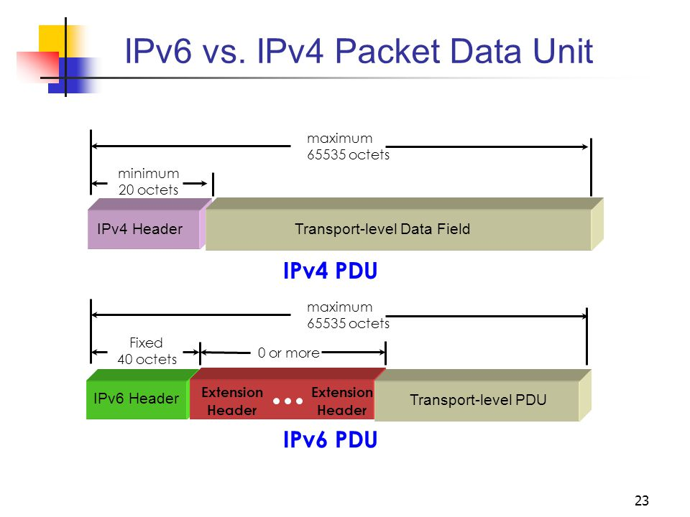

Slide 78
Summary of Header Changes between IPv4 & IPv6
Streamlined
Fragmentation fields moved out of base header
IP options moved out of base header, indicated by “Next Header” field (each of the base and extension headers contains a NEXT HEADER field)
Header Checksum eliminated to reduce processing time at each hop
Header Length field eliminated
Length field excludes IPv6 base header

Slide 79
Summary of Header Changes between IPv4 & IPv6
Revised
Time to Live ’ Hop Limit
Protocol ’ Next Header
Service Type ’ Traffic Class
Addresses increased 32 bits ’ 128 bits
Extended
Flow Label field added, identify datagrams in same “flow.” (e.g., two applications that need to send video can establish a flow on which QoS is guaranteed).

Slide 80
Summary of Main IPv6 Benefits
Larger Addresses (IPv6 has over 10²⁴ addresses per square meter of the Earth’s surface!)
Extended Address Hierarchy (Room for many levels of structured hierarchy and routing aggregation)
Flexible Header Format
IPv6 uses an entirely new and incompatible datagram format that includes a set of optional headers
Improved Options
Provision For Protocol Extension
Support For Autoconfiguration and Renumbering
Support for Resource Allocation

Slide 81
Incidental Benefits of New Deployment
Chance to eliminate some complexity in IP header
improve per-hop processing
Chance to upgrade functionality
multicast, QoS, mobility
Chance to include new features
binding updates
Notes:
incidential
incidental附属的

Slide 82
IPv6 Advanced Features
Stateless/Serverless Address Auto-configuration
Mobility - More efficient and robust mechanisms
Security - Built-in, strong IP-layer encryption and authentication
Quality of Service

Slide 83
IPv6 Extension Headers
The first field of all extension header is a 8-bit “next header” field
IPv6 header
TCP header + data
next header =
TCP
The next header refers the protocol type if no optional head
IPv6 header
Routing header
TCP header + data
next header =
Routing
next header =
TCP
The next header specifies the type of the following header
IPv6 header
Routing header
Fragment header
fragment of TCP
header + data
next header =
Routing
next header =
Fragment
next header =
TCP

Slide 84
Extension Headers
Generally processed only by the final destination, and neglected by the intermediate routers => much lower overhead than IPv4 options processing
exception: Hop-by-Hop Options header
Eliminated IPv4’s 40-byte limit on options
in IPv6, limit is total packet size, or Path MTU in some cases
Currently defined extension headers
Hop-by-Hop Options
Routing
Fragment
Authentication
Encryption
Destination Options
Hop-by-hop header
To speed processing, IPv6 requires that extension headers used by intermediate routers be placed before those used by the final destination
end-to-end headers

Slide 85
IPv6 Fragmentation and Reassembly
Fragmentation of IPv6 datagrams is allowed and specified by an extension header.
In IPv6, fragmentation is end-to-end, i.e., no fragmentation occurs in intermediate routers.
The source/sender can either use the guaranteed minimum MTU of 1280 octets or perform Path MTU Discovery to identify the minimum MTU along the path to the destination.

Slide 86
Minimum MTU
Definitions:
link MTU a link’s maximum transmission unit, i.e., the max IP packet size that can be transmitted over the link
path MTU the minimum MTU of all the links in a path between a source and a destination
Minimum link MTU for IPv6 is 1280 octets (versus 68 octets for IPv4)
On links with MTU < 1280, link-specific fragmentation and reassembly must be used

Slide 87
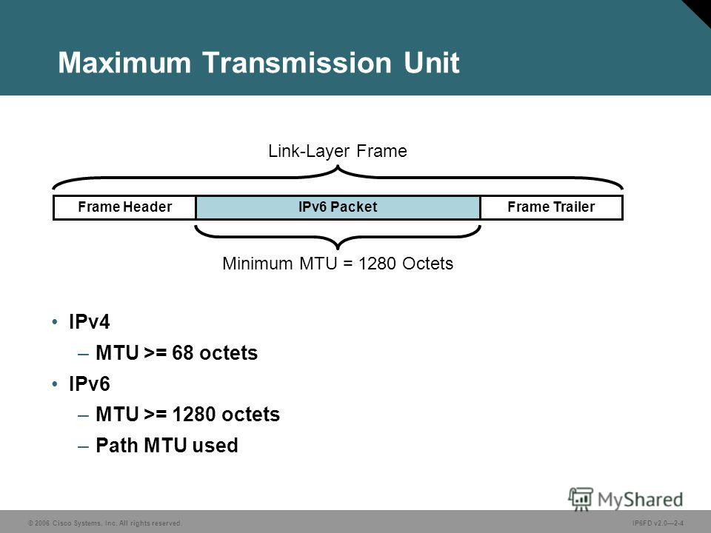

Slide 88
Path MTU Discovery (1)
Implementations are expected to perform path MTU discovery to send packets bigger than 1280 octets:
for each dest., start by assuming MTU of first-hop link
if a packet reaches a link in which it cannot fit, will invoke ICMP “packet too big” message to source, reporting the link’s MTU; MTU is cached by source for specific destination
occasionally discard cached MTU to detect possible increase
Minimal implementation can omit path MTU discovery as long as all packets kept ≤ 1280 octets
e.g., in a boot ROM implementation

Slide 89
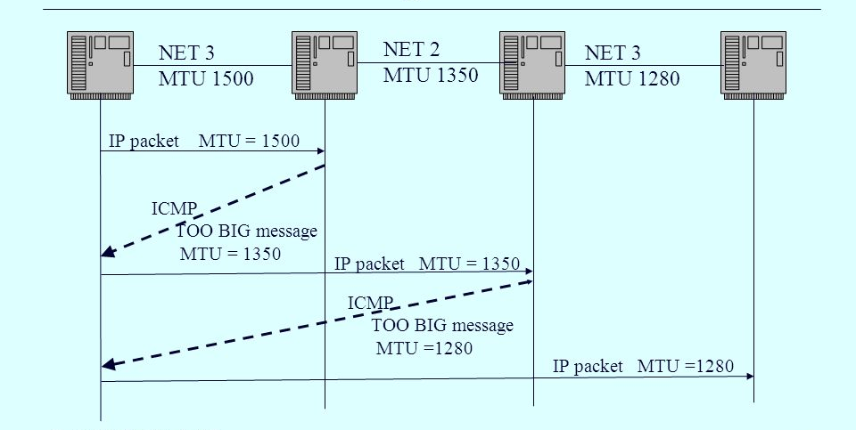
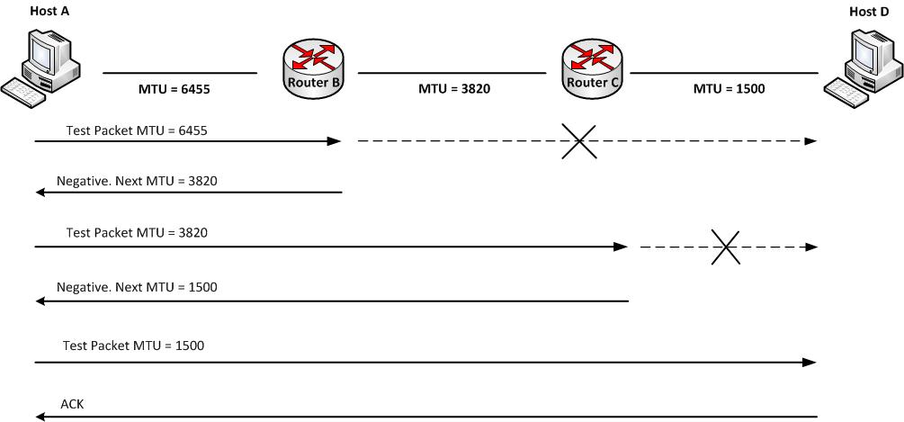
Path MTU Discovery (2)

Slide 90
Fragment Extension Header
Single bit M marks the last fragment
0
8
16
29
31
Next Header
Reserved
Fragment Offset
0 0 M
Original Packet Identifier
Carries a unique ID that receiver uses to group fragments
Reserved and ignored by receiver
IPv6 frag. is an end-to-end function; routers do not fragment packets en-route if too big—they send ICMP “packet too big” instead
Each fragment must be a multiple of 8 octets
IPv6 expands the IPv4 “Identifier” field to 32 bits to accommodate higher-speed networks.

Slide 91
Consequence of End-to-End Fragmentation
End-to-end fragmentation alters the fundamental IPv4 assumption that routes change dynamically.
In IPv6, routes cannot be changed as easily as those in IPv4 because a change in a route can also change the path MTU.
When a router discovers that fragmentation is needed, it sends ICMP error message back to the source. The source performs another path MTU discovery and fragments datagrams again.

Slide 92
Routing Extension Header
The total number of addresses in the list
Size of the routing header
Only type 0 (loose source route) is defined
0
8
16
24
31
Next Header
Hdr Ext Len
Routing Type
Segments Left
Reserved
Address[0]
A list of addresses of routers in the path
Address[1]
•
•
•

Slide 93
Example of Using the Routing Header
S
A
B
S wants to send packet to D though A and B
D

Slide 94
Example of Using the Routing Header
S
A
B
Src Address: S
Dest Address: A
Routing Header Address: B and D
D

Slide 95
Example of Using the Routing Header
S
A
B
Src Address: S
Dest Address: B
Routing Header Address: D
D

Slide 96
Example of Using the Routing Header
S
A
B
Src Address: S
Dest Address: D
D

Slide 97
IPv6 Colon Hexadecimal Notation
104.230.140.100.255.255.255.255.0.0.17.128.150.10.255.255
Q: How can humans read, enter and manipulate the long IPv6 addresses?
Binary notation is obviously untenable
An example using dotted decimal notation to express a 128-bit number
104.230.140.100.255.255.255.255.0.0.17.128.150.10.255.255
To help make addresses more compact and easier to enter, colon hexadecimal notation (abbreviated colon hex) is proposed.
68E6:8C64:FFFF:FFFF:0:1180:96A:FFFF
Colon hex notation requires fewer digits and fewer separator characters than dotted decimal
8 bits
16 bits
Omit the first 3 zeros
Omit the first zero
Notes:
untenable
生词本
英 [ʌnˈtenəbl]
美 [ʌnˈtɛnəbəl]
adj.（尤指辩论中的立场）站不住脚的； 不能维持的； 难以防守的； 不能租赁的
站不住脚的；
站不住脚；
支持不住的；
难以防守的
colon 搜索网络
英 [ˈkəʊlən] 美 [ˈkoʊlən]
GRE
n. 冒号;

Slide 98
Useful Techniques of Colon Hex Notation
Zero compression (applied only once in any address)
FF05:0:0:0:0:0:0:B3 → FF05::B3
Incorporation of dotted decimal suffixes (intended to be used during the transition from IPv4 to IPv6, IPv4-compatible)
0:0:0:0:0:0:128.10.2.1 → ::128.10.2.1 (similar to IPv4)
CIDR-like notation (specify network prefix)
12AB::CD30:0:0:0:0/60 = 12AB:0:0:CD30::/60
Cancelled in 2006

Slide 99
IPv6 - Addressing Model
Like IPv4, IPv6 associates an address with a specific network connection (i.e., a physical network is assigned a prefix).
IPv6 also permits multiple, simultaneous addresses assigned to a given interface.
Addresses have scope,
Link local
Site local
Global
Addresses have lifetime
Valid and preferred lifetime
Global
Site-Local
Link-Local

Slide 100
Three Basic IPv6 Address Types
Unicast
Destination Address specifies a single computer
Delivery to single interface
Anycast
Destination is a set of computers, possibly at different location, that all share a single address
Delivery to exactly one member in the set (often the closest member)
Multicast
Destination is a set of computers, possibly at multiple locations.
Delivery to each member in the set using hardware multicast or broadcast if viable

Slide 101
Non-global unicast address
:: Unspecified address or source address used during bootstrap
::1 Loopback address (like 127.0.0.1)
Site-local address
Unique in a site, like private address of IPv4
Link-local address
Unique in a link, specify an interface to reduce ambiguity in a node
Used only for special purpose, e.g. exchanging msg among nodes within a network segment
Notes:
:: → 0:0:0:0:0:0:0:0
::1 → 0:0:0:0:0:0:0:1

Slide 102
Proposed IPv6 Address Space Assignment
Address type Binary prefix
IPv4-compatible 0000...0 (80 zero bits)+FFFF
global unicast 001
link-local unicast 1111 1110 10
site-local unicast 1111 1110 11 → fec0::/10 (deprecated)
multicast 1111 1111
Only 15% of the address space has been assigned at present
anycast addresses allocated from unicast prefixes

Slide 103
IPv4 Compatible Addresses
The encoding of an IPv4 address in an IPv6 address
The encoding will be needed during a transition from IPv4 to IPv6
Upgrade before being assigned a valid IPv6 address
A computer running IPv6 software may need to communicate with a computer that runs only IPv4 software.
80 bits
16 bits
32 bits
IPv4 →
IPv6 addresses
0000..................0000 FFFF IPv4 address

Slide 104
Global Unicast Addresses
0
48
64
127
001
Global Routing
Prefix (45 bits)
Subnet
ID (16bits)
Interface ID (64bits)
IPv6 unicast addressing structure resembles the IPv4 subnet addressing scheme
Three conceptual parts:
Global unique prefix: route the datagram
Subnet ID: distinguish among multiple physical networks a given site
Interface ID: identify a particular connection to the subnet

Slide 105
Link-Local & Site-Local Unicast Addresses
FE8x ∼ FEBx－link local Address：FE80::/10
restricted to a single network
10 bits
54 bits
64 bits
1111111010
0
Interface ID
FEDx ∼ FEFx－Site local Addresses：FEC0::/10 (deprecated)
for use LAN locally and can’t be forwarded to the global Internet
10 bits
38 bits
16 bits
64 bits
1111111011
0
Subnet ID
Interface ID

Slide 106
Interface IDs
Lowest-order 64-bit field of unicast address may be assigned in several different ways:
auto-configured from a 64-bit EUI-64, or expanded from a 48-bit MAC address (e.g., Ethernet address)
auto-generated pseudo-random number (to address privacy concerns)
assigned via DHCP
manually configured
possibly other methods in the future

Slide 107
EUI-64 to IPv6 Address
The IEEE defined 64-bit extended unique identifier (EUI-64) is a concatenation of the 24-bit company_id value by the IEEE Registration Authority and a 40-bit extension identifier assigned by the organization with that company_id assignment
EUI-64, after setting G/L bit=1, can be put into the “Interface ID” field of IPv6 address.

Slide 108
Ethernet Address to IPv6 Address
G/L bit
I/G bit
bit 0 8 24 47
IEEE 802 address
cccccc0gcccccccccccccccc
低 24 位
bit 0 8 24 40 63
Interface
ID
cccccc1gcccccccccccccccc 1111111111111110
低 24 位
0xFFFE
G/L = 1

Slide 109
Unit 2: IP Technology
2. 1 Introduction
2.2 Virtual circuit and datagram networks
2.3 IPv4
Datagram format
IPv4 addressing
ICMP
2.4 IPv6:
Protocol Background
Technology Highlights
IPv4-IPv6 Coexistence/Transition
Next Steps

Slide 110
Transition From IPv4 To IPv6
Not all routers can be upgraded simultaneously
no “flag days”
How will the network operate with mixed IPv4 and IPv6 routers?
IPv6 deployments will occur piecewise from the edge
Core infrastructure only moving when significant customer usage demands it
Whenever possible, devices and applications should be capable of both IPv4 & IPv6, to minimize the delays and potential failures inherent in translation points

Slide 111
Transition / Co-Existence Techniques
A wide range of techniques have been identified and implemented, basically falling into three categories:
(1) dual-stack techniques, to allow IPv4 and IPv6 to co-exist in the same devices and networks
(2) tunneling techniques, IPv6 carried as payload in IPv4 datagram among IPv4 routers
(3) translation techniques, to allow IPv6-only devices to communicate with IPv4-only devices
Expect all of these to be used, in combination.

Slide 112
Tunneling
dual stack
dual stack
IPv4 network
A
B
E
F
Logical view:
tunnel
IPv6
IPv6/IPv4
IPv6/IPv4
IPv6
A
B
E
F
Physical view:
IPv6
IPv6/IPv4
IPv4
IPv4
IPv6/IPv4
IPv6

Slide 113
Tunneling
dual stack
dual stack
IPv4 network
A
B
E
F
Logical view:
tunnel
IPv6
IPv6/IPv4
IPv6/IPv4
IPv6
A
B
C
D
E
F
Physical view:
IPv6
IPv6/IPv4
IPv4
IPv4
IPv6/IPv4
IPv6
Flow: X
Src: A
Dest: F
data
Src:B
Dest: E
Src:B
Dest: E
Flow: X
Src: A
Dest: F
data
Flow: X
Src: A
Dest: F
data
Flow: X
Src: A
Dest: F
data
A-to-B:
IPv6
B-to-E:
IPv6 inside
IPv4
B-to-E:
IPv6 inside
IPv4
E-to-F:
IPv6

Slide 114
Serverless Autoconfiguration
Hosts can construct their own addresses:
subnet prefix(es) learned from periodic multicast advertisements from neighboring router(s)
interface IDs generated locally
Other IP-layer parameters also learned from router adverts (e.g., router addresses, recommended hop limit, etc.)
Higher-layer info (e.g., DNS server and NTP server addresses) discovered by multicast / anycast-based service-location protocol.

Slide 115
Translation
This is a simple extension to NAT techniques, to translate header format as well as addresses
IPv6 nodes behind a translator get full IPv6 functionality when talking to other IPv6 nodes located anywhere
they get the normal (i.e., degraded) NAT functionality when talking to IPv4 devices

Slide 116
Unit 2: IP Technology
2. 1 Introduction
2.2 Virtual circuit and datagram networks
2.3 IPv4
Datagram format
IPv4 addressing
ICMP
2.4 IPv6:
Protocol Background
Technology Highlights
IPv4-IPv6 Coexistence/Transition
Next Steps

Slide 117
So what can I do?
Begin porting NOW!
Establish test networks to verify configurations, and application compatibility

Slide 118
For More Information
http://www.ietf.org/html.charters/ipngwg-charter.html
http://www.ietf.org/html.charters/ngtrans-charter.html
http://playground.sun.com/ipv6/
http://www.6bone.net/ngtrans/

Slide 119
For More Information
http://www.6bone.net
http://www.ipv6forum.com
http://www.ipv6.org
http://www.cisco.com/ipv6/
http://www.microsoft.com/windows2000/library/howitworks/communications/networkbasics/IPv6.asp

Slide 120
Homework 1:
The benefits of IPv6 when compared with IPv4

Slide 121
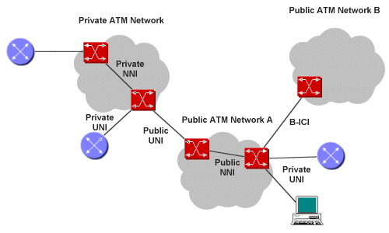
Homework 2:
Investigate the status quo of ATM deployment.

Slide 122
Homework 3: IPv6 Timeline (Development and Implementation of IPv6 network), up to 5 slides
2000
2001
2002
2003
2004
2005
2006
2007
Q1
Q2
Q3
Q4
Q1
Q2
Q3
Q4
Q1
Q2
Q3
Q4
Q1
Q2
Q3
Q4
Q1
Q2
Q3
Q4
Q1
Q2
Q3
Q4
Q1
Q2
Q3
Q4
Q1
Q2
Q3
Q4
Early adopter
Application porting <= Duration 3+ years
=>
ISP
adoption <= Duration 3+ years
=>
Consumer adoption <= Duration 5+ years
=>
Enterprise adoption
<= Duration 3+ years =>

Slide 123
Homework 1: About VC implementation
Why doesn't a packet just keep the same VC number on each of the links along its route?

Slide 124
Homework 5:
Private addresses in IPv6

